Slide 1

DB Design fine tuning: Normalization
CS3083-B Prof. Arfaoui

Slide 2
Problem: Redundancy
Redundancy: storing the same data in different places can cause problems when updates or changes to data are required
Data redundancy leads to semantic anomalies which, in turn, make automatic data processing and database maintenance difficult.
Redundancy results in inefficient use of memory and data anomalies. Any data that is redundant in the database is an error waiting to happen.

Slide 3
Database anomalies
INSERTION ANOMALY: occurs when the insertion of certain data necessitates the presence of other data.
UPDATE ANOMALY: occurs when performing an update to a record. If data is stored redundantly in the same table, and the update misses any of them, then there will be data inconsistency.
DELETION ANOMALY: occurs when the deletion of a certain data (undesired) causes other data (desired) to be deleted as well.

Slide 4
Normalization is the Solution
Normalization is the process of efficiently organizing data in a database.
It is a multistep strategy implemented to eliminate data redundancy and protect the integrity of relational databases.
It often results in dividing a table into several and connecting them to each other by primary and foreign keys.
The goal is to isolate data so that manipulating (adding, deleting or modifying) data across a column can be done in a single table, and propagates to the rest of the database through relationships.
It also ensures data dependencies and the logical storage of data.

Slide 5
normalized database
A database is normalized if it is at least in 3rd normal form.
The normalization process is composed of the following normal forms:
1NF: -- [our focus]
2NF: -- [our focus]
3NF: -- [our focus]
BCNF: -- [our focus]
4NF: -- [out of CS 3083 scope]
5NF: -- [out of CS 3083 scope]
6NF: -- [out of CS 3083 scope]

Slide 6
FIRST NORMAL FORM (1NF)
For a table to be in first normal form (1NF), it must comply with the following requirements:
Data is atomic and has no multivalued columns/attributes
Has a key that uniquely and stably identifies each line
Values stored in a column should be of the same domain
Has no repeating columns/attributes

Slide 7
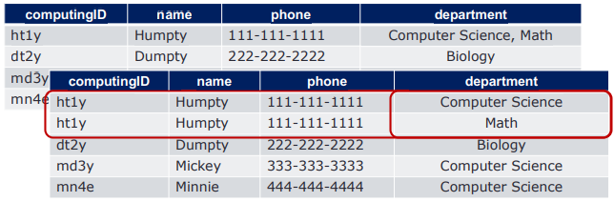
FIRST NORMAL FORM (1NF)
Data is atomic and has no multivalued columns/attributes
Has a key that uniquely and stably identifies each line
Values stored in a column should be of the same domain
Has no repeating columns/attributes

Slide 8
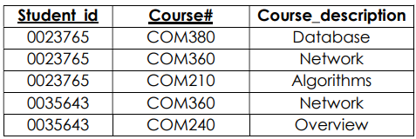
PARTIAL FUNCTIONAL DEPENDENCY
A FD (XY → Z) is said to be partial, if there exists Z such that: X → Z or Y → Z.
XY is the primary key (composite) and Z depends only on parts of it.
The primary key for student table is a composite key {Student_id, Course#}
{Course#} → Course_description
If we know the Course#, we can determine the Course_description.
We say that Course_description is partially dependent on the Primary Key

Slide 9
Second NORMAL FORM (2NF)
For a table to be in first normal form (2NF), it must comply with the following requirements:
Must be in first normal form.
Has NO partial dependency. Any non-key column/attribute must only depend on the primary key as a whole. In other words, none of the columns/attributes would depend only on a portion of the key.
Note: A table in 1NF having a non-composite primary key is always in 2NF.

Slide 10
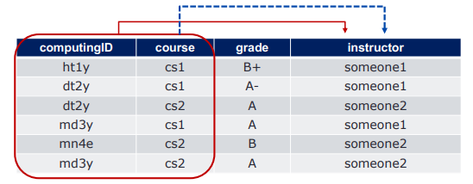
Second NORMAL FORM (2NF)
1NF + No partial dependency
Suppose we also know course → instructor
We have R (computingID, course, grade, instructor), {computingID, course} is a candidate key FDs {computingID, course → grade, computingID, course → instructor, course → instructor }
Since course is part of a candidate key, instructor depends on a part of a key “Partial dependency”
Not satisfy 2NF -- Fix it!

Slide 11
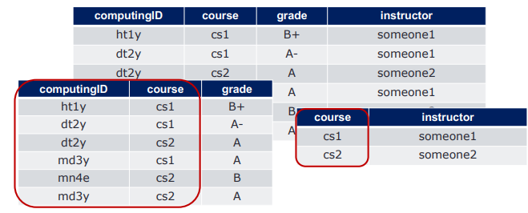
Second NORMAL FORM (2NF)
To convert the table into 2NF, decompose the table to remove partial dependency
course → instructor
computingID, course → grade
Non-key attributes must depend upon the whole of the candidate key

Slide 12
Third NORMAL FORM (3NF)
For a table to be in third normal form (3NF), it must comply with the following requirements:
Must be in second normal form.
Has NO transitive dependency. All columns/attributes must depend directly on the key. In other words, no attribute should depend on another non-key attribute.

Slide 13
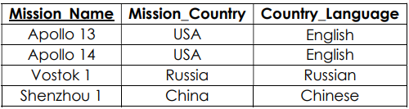
TRANSITIVE FUNCTIONAL DEPENDENCY
A functional dependency (X → Z) is said to be transitive if there exists Z such that
X → Y and Y → Z. X → Z is indirectly formed by two functional dependencies
For transitive dependency to occur, at least three attributes are required.
If we know the Mission_Name, we can determine the Mission_Country.
Mission_Name → Mission_Country
If we know the Mission_Country, we can determine the Country_Language.
Mission_Country → Country_Language
The following transitive dependency is indirectly formed by the two previous FDs. If we know the Mission_Name we can determine the Country_Language.
Mission_Name → Country_Language

Slide 14
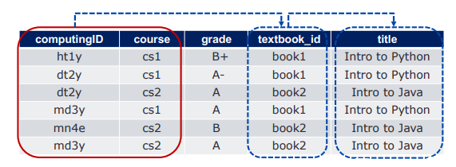
Third NORMAL FORM (3NF)
2NF + No transitive dependency
Suppose we want to keep track of textbook_id and title for the course
We have R(computingID, course, grade, textbook_id, title), {computingID, course} is a candidate key
FDs {computingID, course → grade, computingID, course → textbook_id, textbook_id → title }
Since computingID, course → textbook_id, textbook_id → title
textbook_id and title are non keys -- “transitive dependency”
Not satisfy 3NF -- Fix it!

Slide 15
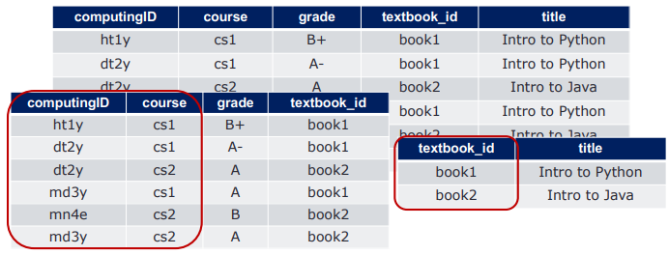
Third NORMAL FORM (3NF)
To convert the table into 3NF, decompose the table to remove transitive dependency
textbook_id → title
{computingID, course} → grade
{computingID, course} → textbook_id
Non-key attributes must depend upon the whole of the candidate key

Slide 16
Boyce-Codd Normal Form (BCNF)
For a table to be to comply with (BCNF), it must meet the following requirements:
Must be in third normal form.
A non-key attribute does not imply a key attribute - All dependencies must be from full key

Slide 17
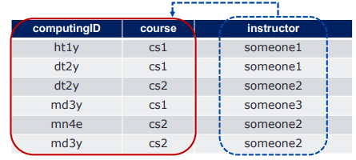
Boyce-Codd Normal Form (BCNF)
3NF + All dependencies must be from full key
Suppose we know that:
instructor → course
We have R(computingID, course, instructor), {computingID, course} is a candidate key
FDs {computingID, course → instructor, instructor → course }
Since instructor → course, non-key implies a (part of) key
Not satisfy BCNF -- Fix it!

Slide 18
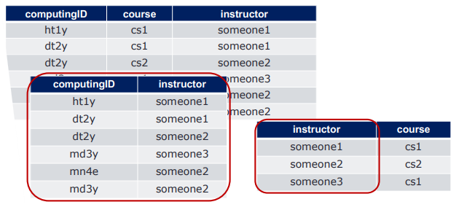
Boyce-Codd Normal Form (BCNF)
To convert the table into BCNF, decompose the table to remove non-keys that imply a key – to make all dependencies from a key
Given, FDs {computingID, course → instructor, instructor → course }
Lost
No transitive FDs, no non-key dependencies, but can lose FDs

Slide 19
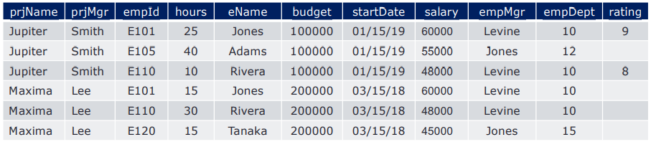
Practice
Let’s consider the work_project table that stores information about projects, assignment, and budget and hour allocation.
work_project
Notice that the table consists of many attributes, some data are redundant.

Slide 20
Assumptions We Made
Each project has a unique name
Names of employees and managers are not unique
Each project has one manager, whose name is stored in prjMgr
Many employees can be assigned to work on each project
An employee can be assigned to more than one project
The attribute hours tells the number of hours per week a particular employee is assigned to work on a particular project
budget stores the amount budgeted for a project
startDate gives the starting date for a project
salary gives the annual salary of an employee

Slide 21
Assumptions We Made (2)
empMgr gives the name of the employee’s manager, who might not be the same as the project manager
empDept gives the employee’s department
Department names are unique
Each department has only one manager
The employee’s manager is the manager of the employee’s department
rating gives the employee’s rating for a particular project
The project manager assigns the rating at the end of the employee’s work on that project

Slide 22
List of FDs
Based on the assumptions, we can list the following FDs
prjName → prjMrg, budget, startDate
empId → empName, salary, empMgr, empDept
prjName, empId → hours, rating
empDept → empMgr
Since we assumed people’s names were not unique, empMgr does not functionally determine empDept.
prjMgr does not determine prjName.

Slide 23
Is work_project Table in 1NF?
work_project
prjName → prjMrg, budget, startDate
empId → empName, salary, empMgr, empDept
prjName, empId → hours, rating
empDept → empMgr
Check if there is a column that is not atomic.
With a composite key {prjName, empId}, each column would be single valued. Thus, the work_project table is in 1NF

Slide 24
Is work_project Table in 2NF?
prjName → prjMrg, budget, startDate Given FDs
empId → empName, salary, empMgr, empDept
prjName, empId → hours, rating
empDept → empMgr
Check if there is a partial dependency.
The work_project has partial dependencies, violating 2NF
prjName → prjMrg, budget, startDate
empId → empName, salary, empMgr, empDept

Slide 25
Put work_project Table in 2NF?
The work_project has partial dependencies, violating 2NF
prjName → prjMrg, budget, startDate
empId → empName, salary, empMgr, empDept
Thus, transform the work_project table into an equivalent set of 2NF relations by projection, resulting in:
Project(prjName, prjMgr, budget, startDate)
Employee(empId, empName, salary, empMgr, empDept)
Work(@prjName, @empID, hours, rating)

Slide 26
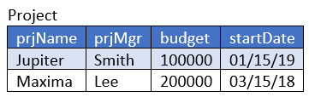
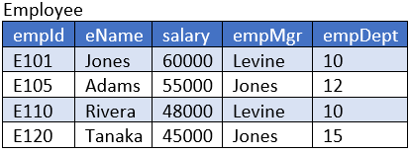
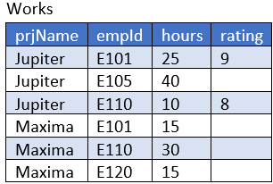
work_project Table in 2NF

Slide 27

Is work_project in 3NF?
Project(prjName, prjMgr, budget, startDate)
Employee(empId, empName, salary, empMgr, empDept)
Work(@prjName, @empID, hours, rating)
Check if there is a transitive dependency.
Check if there is a non-key attribute or combination of attribute that functionally determines another non-key attribute

Slide 28
Is work_project in 3NF?
Project(prjName, prjMgr, budget, startDate)
Employee(empId, empName, salary, empMgr, empDept)
Work(@prjName, @empID, hours, rating)
prjName → prjMrg, budget, startDate Given FDs
empId → empName, salary, empMgr, empDept
prjName, empId → hours, rating
empDept → empMgr
Check if there is a transitive dependency.
Project: No transitive dependency in Project. Thus it is in 3NF.
Employee: There is a transitive dependency since empDept → empMgr.
Since empDept is not a superkey, nor is empMgr part of a candidate key, this violates 3NF. Thus, we need to decompose Employee
Employee(empId, empName, salary, @empDept)
Department(empDept, empMgr)

Slide 29
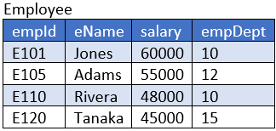
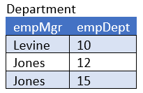
decomposing Employee

Slide 30
work_project in 3NF?
Project(prjName, prjMgr, budget, startDate)
Employee(empId, empName, salary, empMgr, empDept)
Work(@prjName, @empID, hours, rating)
prjName → prjMrg, budget, startDate Given FDs
empId → empName, salary, empMgr, empDept
prjName, empId → hours, rating
empDept → empMgr
Project(prjName, prjMgr, budget, startDate)
Employee(empId, empName, salary, @empDept)
Department(empDept, empMgr)
Work(@prjName, @empID, hours, rating)

Slide 31
work_project in 3NF?
Project(prjName, prjMgr, budget, startDate)
Employee(empId, empName, salary, @empDept)
Department(empDept, empMgr)
Work(@prjName, @empID, hours, rating)

Slide 32
work_project in BCNF?
prjName → prjMrg, budget, startDate Given FDs
empId → empName, salary, empMgr, empDept
prjName, empId → hours, rating
empDept → empMgr
Project(prjName, prjMgr, budget, startDate)
Employee(empId, empName, salary, @empDept)
Department(empDept, empMgr)
Work(@prjName, @empID, hours, rating)
Check if there is a determinant that is not a superkey

Slide 33
Take Away
Be able to identify reasonable / applicable FDs
Understand the characteristics of each normal form
Given a set of tables, you should be able to analyze and determine whether the given tables are in a certain normal form.
If they are not, which tables (or part of the tables) violate the properties. You should be able to fix all the violations such that the set of tables are in the desired normal form.
If you choose to use 3NF, all tables must be in 3NF.
• If you choose to use BCNF, all tables must be in BCNF.

